Slide 1


Slide 2
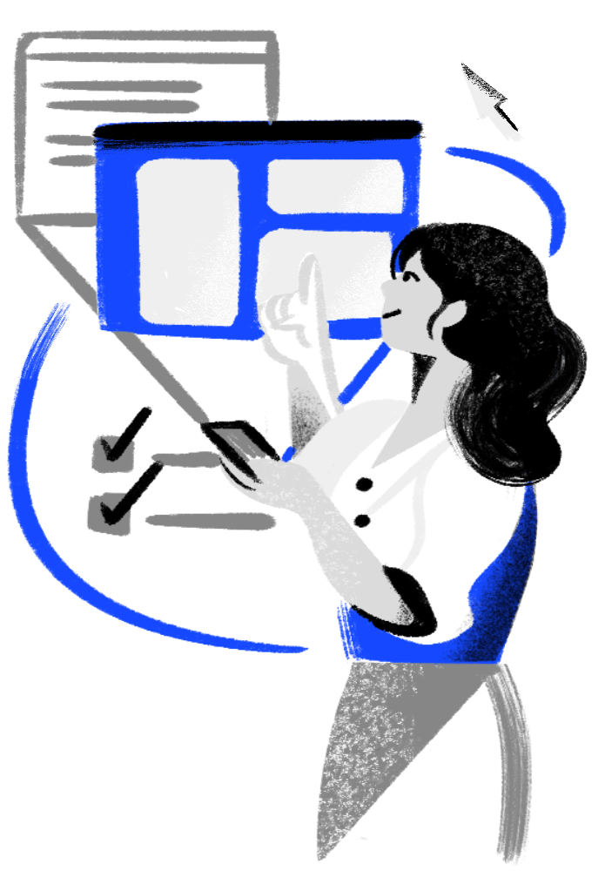

Surveillance
&
Digital Privacy
Understanding How to Protect Your Data in a Connected World
Yuxiang ZHANG
Nouriddin BOUKHZAR
2

Slide 3
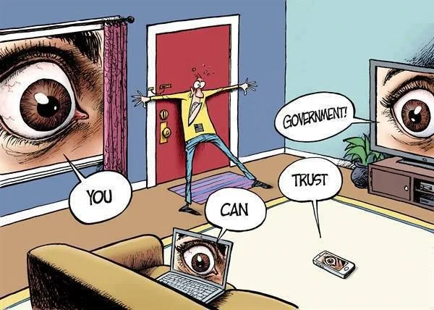
Table of contents
Introduction
Importance of the subject
How They Spy on Us
The Illusion of Consent
How to Fight Back
Individual actions
Legal and collective responses
The Future of Privacy
AI, IoT, and new digital challenges
3

Slide 4
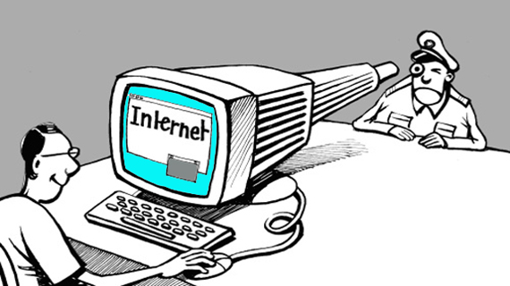
What is Surveillance?
Surveillance = Systematic observation of people’s activities, communications, or behaviors
Online Surveillance
Observation of online behavior
By:
Governments – security & policing
Corporations – ads & tracking
Individuals – social media
4

Slide 5
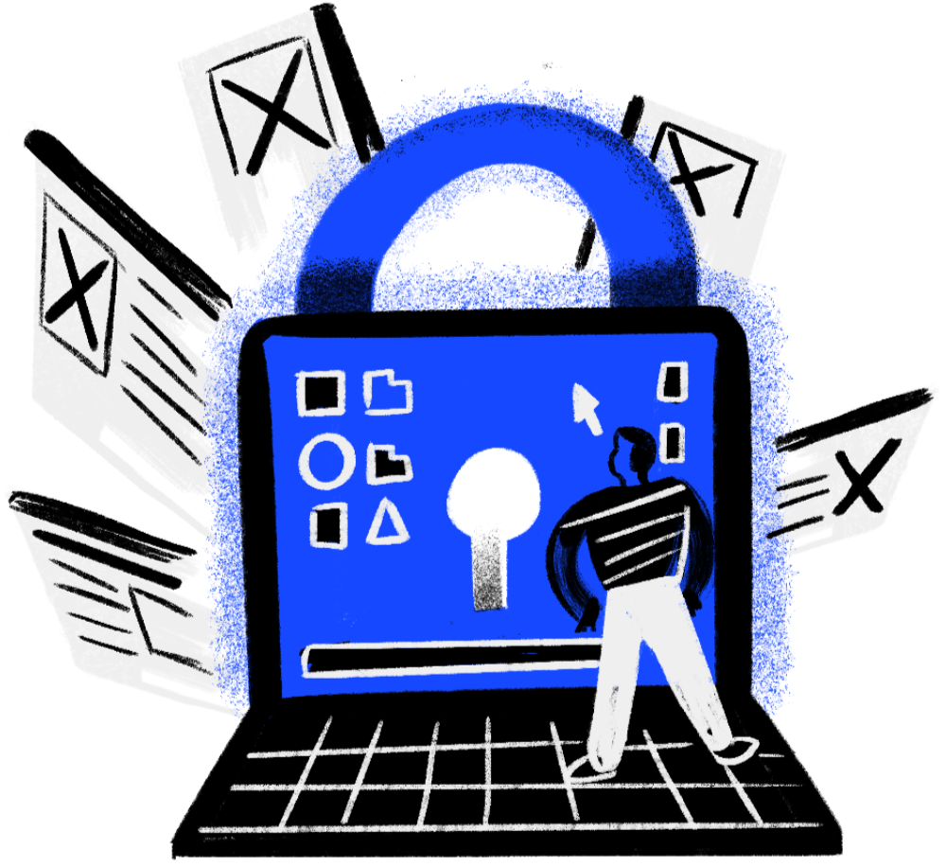
What is Digital Privacy?
Digital Privacy = control over personal data shared online
Decide what, when, with whom to share
5

Slide 6
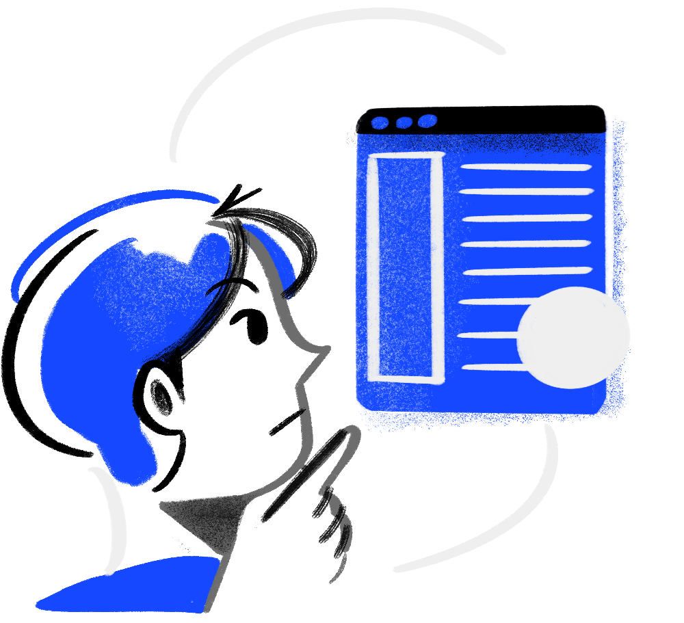
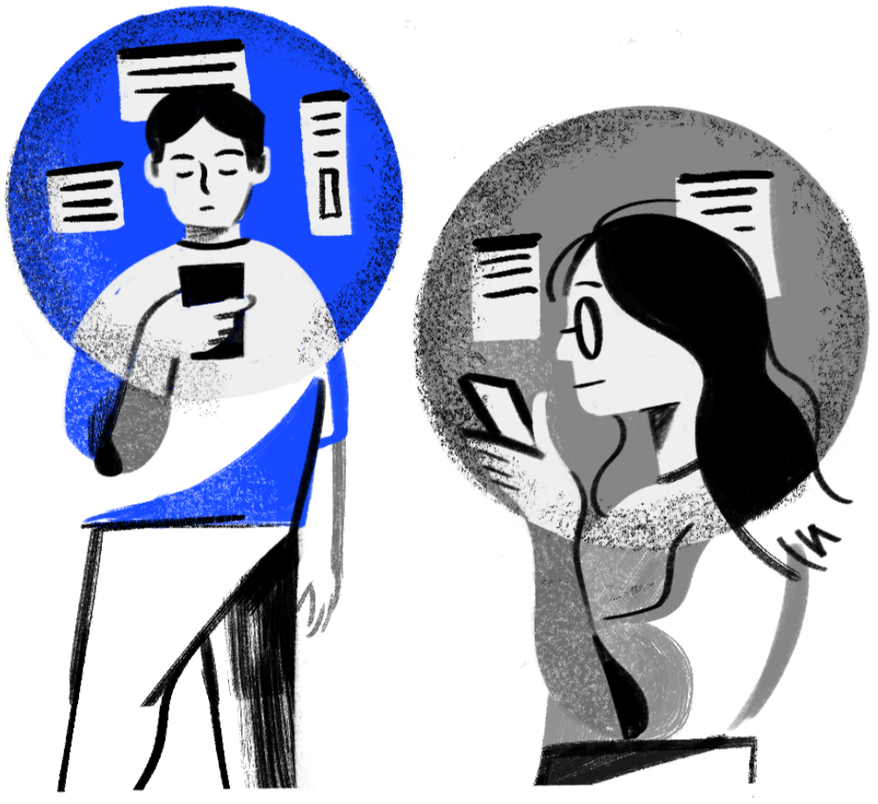
Why should I care?
6

Slide 7
Why should I care?
I’ve got nothing to hide!
7

Slide 8
It’s not about “hiding”
8

Slide 9
It’s not about “hiding”
It’s about control and consent
Control over your data
Data collection with consent
9

Slide 10

Power imbalance
They see everything,
You see nothing...
10

Slide 11
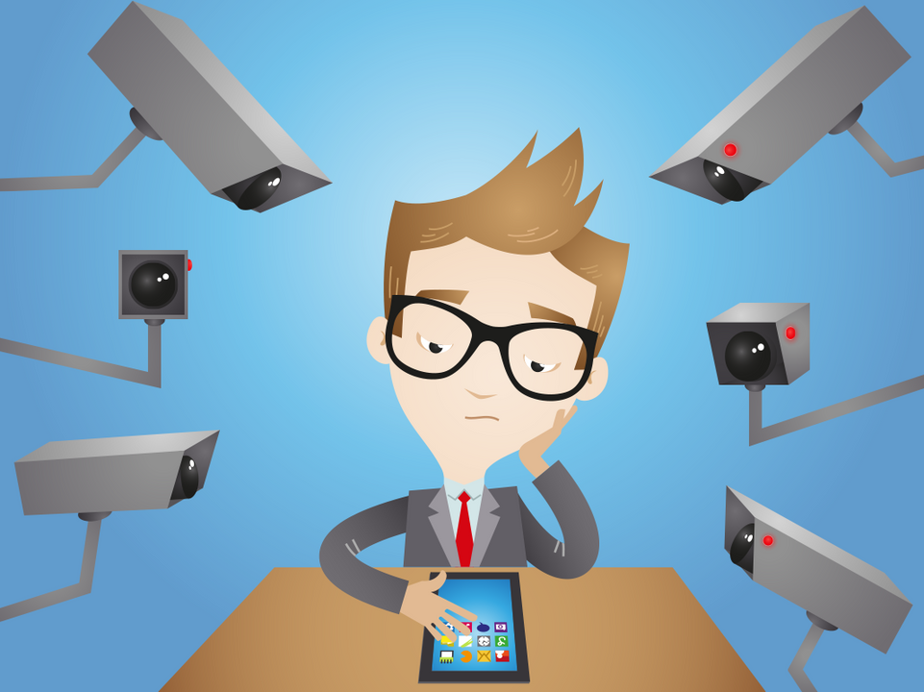
Okay, but how bad is it?
A lot. A whole lot.
11

Slide 12
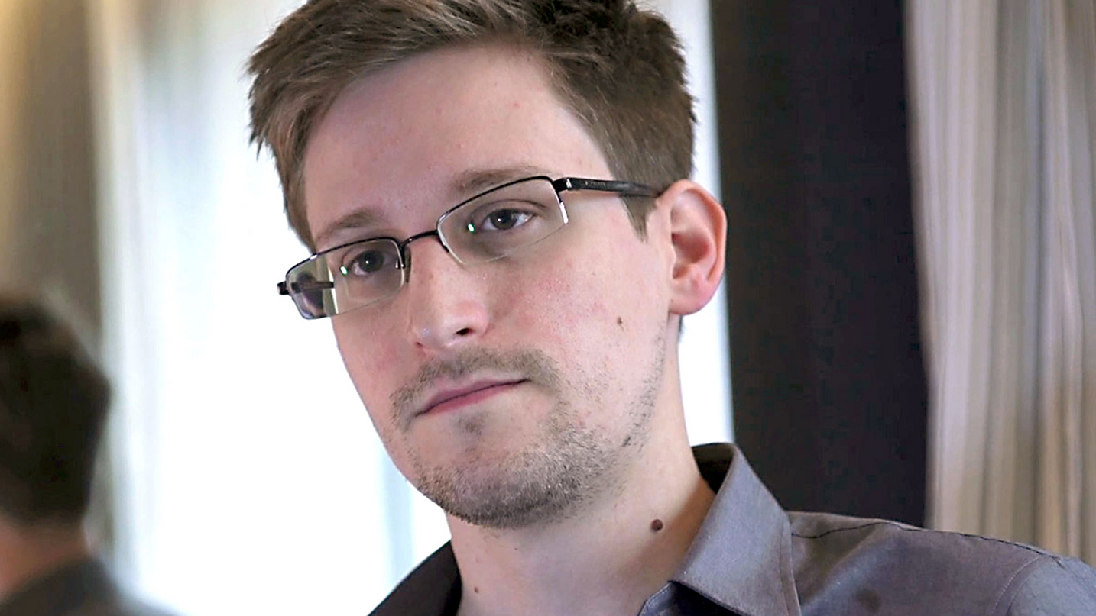
The Snowden leaks
Revealed the existence of numerous mass surveillance programs
The NSA and the Five Eyes being the main actors
12

Slide 13


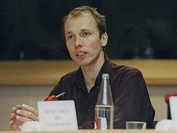
State Mass Surveillance
“You could read anyone’s email […] any computer can be watched […] It’s a one-stop shop for NSA access.”
- Snowden
(quote shortened)
Nicky Hager, a journalist from New Zealand who testified before the European Parliament and provided specific details about the ECHELON surveillance system
Stores data based on demand made to major internet companies (Microsoft, Apple,...)
13

Slide 14
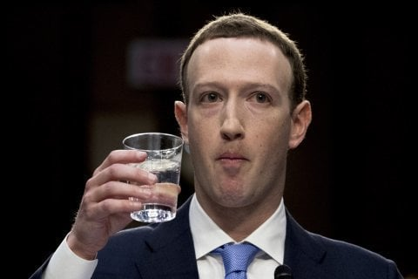
Facebook & Shadow profiles
“In general, we collect data on people who are not signed up for security purposes”
- Mark Zuckerberg
14

Slide 15
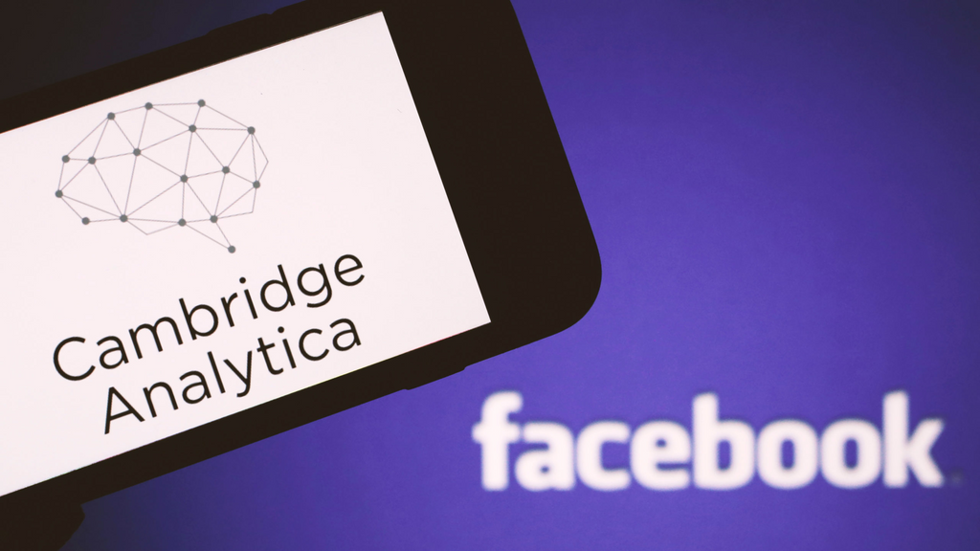
The Cambridge Analytica scandal
Harvested data from ~87 million Facebook users
Built detailed behavioral profiles
Used the data for political microtargeting
15

Slide 16
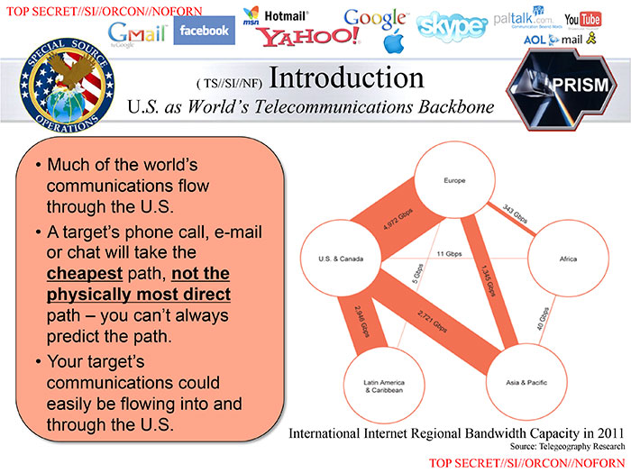
Quick note
When we speak about the US, that doesn’t mean other countries aren’t concerned
16

Slide 17
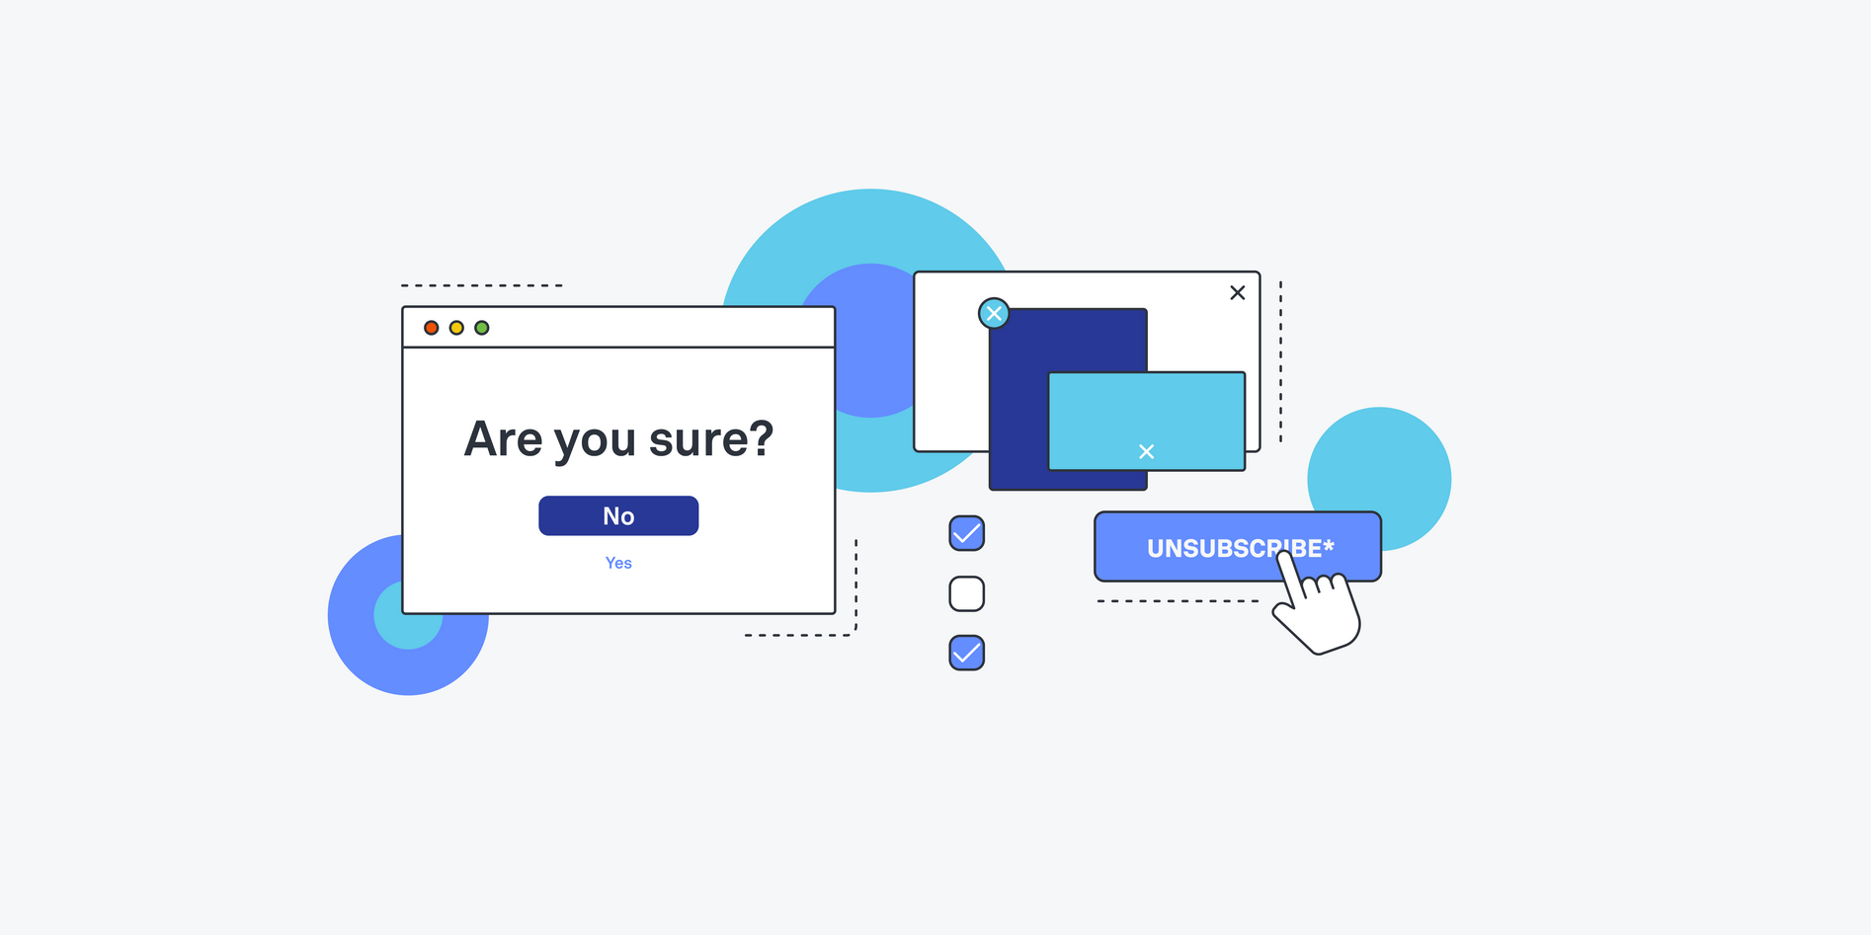
The illusion of consent
Illusion of Consent = apparent agreement without real choice
Key Issues:
Unread privacy policies
Dark patterns in UX design
Lack of real alternatives
Informed consent vs. Forced consent
17

Slide 18
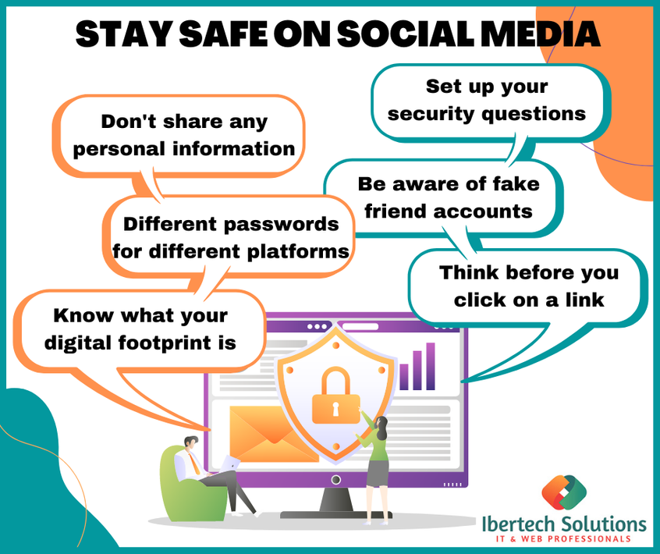


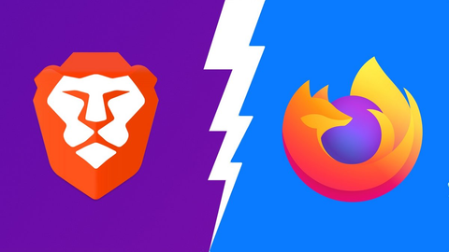
How to fight back
(individual actions)
Use ad blockers and VPNs
Choose private browsers (Firefox, Brave)
Avoid social media logins everywhere
Think before you click
18

Slide 19



How to fight back
(Legal & Collective Actions)
GDPR – gives users control over personal data
Privacy movements – raise awareness & demand change
Advocacy & campaigns – push for stronger protections
19

Slide 20
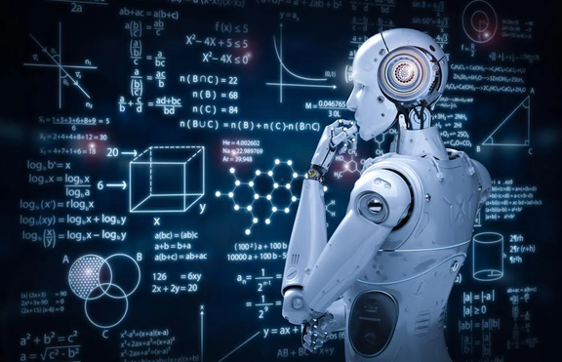
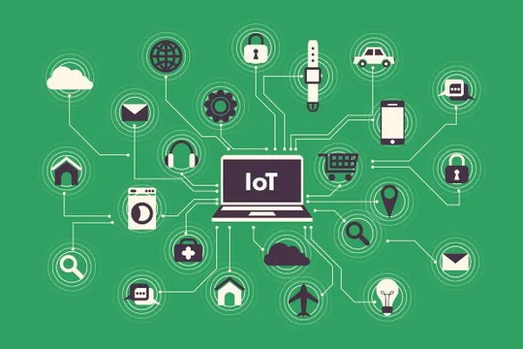
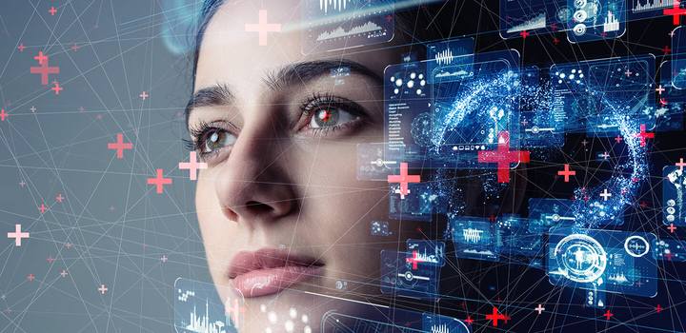
The Future of Digital Privacy
AI & machine learning – deeper profiling, predictive analytics
IoT devices – constant data collection at home/work
Digital IDs & biometrics – centralized identity, tracking risk
20

Slide 21
In conclusion
Mass surveillance is a real issue and spreading awareness is important.
Learning how to protect your data matters, but so does finding a healthy balance that fits your own life.
21

Slide 22

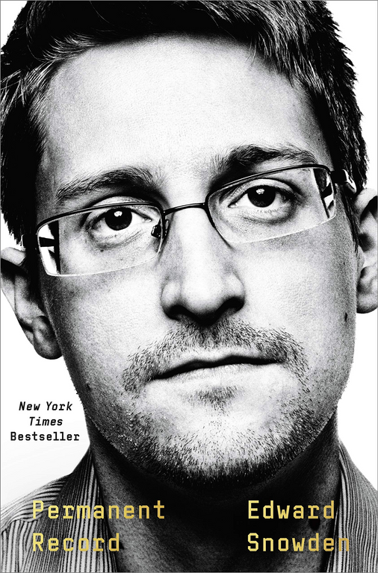

Further reading
22

Slide 23
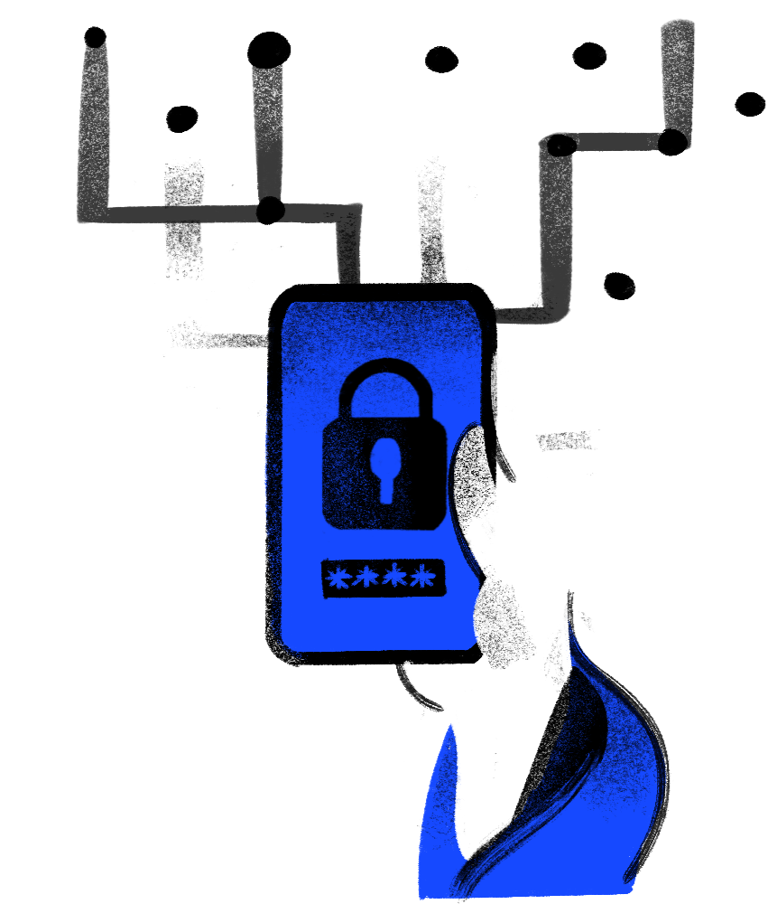

Thank
you
Take Control of Your Digital Footprint
23

Slide 24
Bibliography
https://digdeeper.club/
https://digdeeper.club/articles/browsers.xhtml
https://thehackernews.com/2013/06/digital-privacy-internet-surveillance.html
https://www.enzuzo.com/blog/digital-privacy-definition
https://unixdigest.com/articles/there-is-no-such-thing-as-privacy-on-the-internet.html
https://news.ycombinator.com/item?id=28656580
https://en.wikipedia.org/wiki/Dark_pattern
https://surfshark.com/research/chart/data-collection-mobile-browsers?srsltid=AfmBOor4iaDURjTpKjIcBtO7271buSp5YsbAHe5E1yFN0E6GeRbCSfAy
https://en.wikipedia.org/wiki/Virtual_private_network
https://en.wikipedia.org/wiki/General_Data_Protection_Regulation
https://en.wikipedia.org/wiki/Internet_of_things
https://en.wikipedia.org/wiki/PRISM
24

